Slide 1




6
Power BI
Manager Guide
Prepared By :
Said Fawzy
Manager of Information Center
Tendering Department
Arab Contractors

Slide 2

Chapter 6: Business Reports Examples

Slide 3
01
Project Management
02
Marketing -Sales
Module Contents
HR
03
Tendering
04

Slide 4
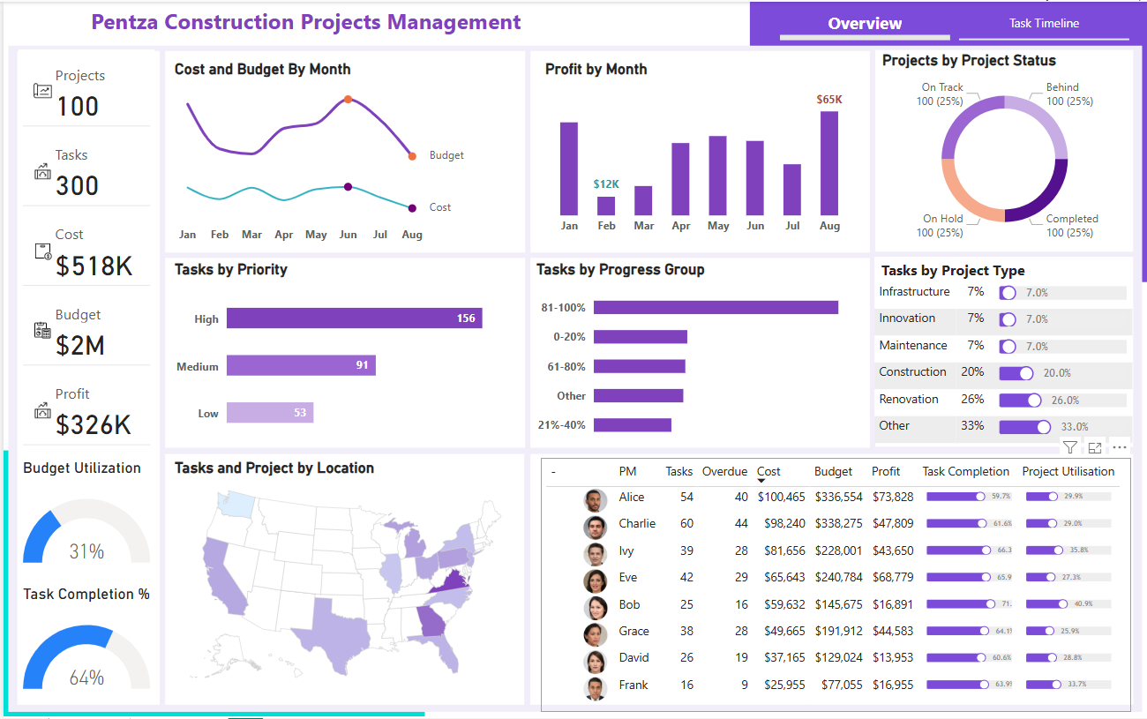
Projects Management

Slide 5
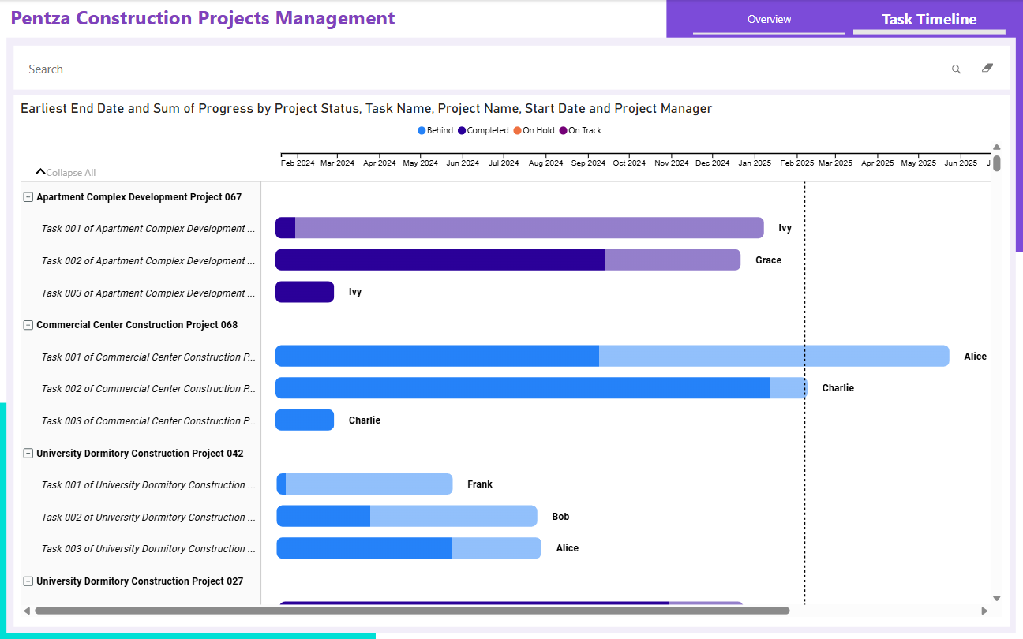
Projects Management

Slide 6
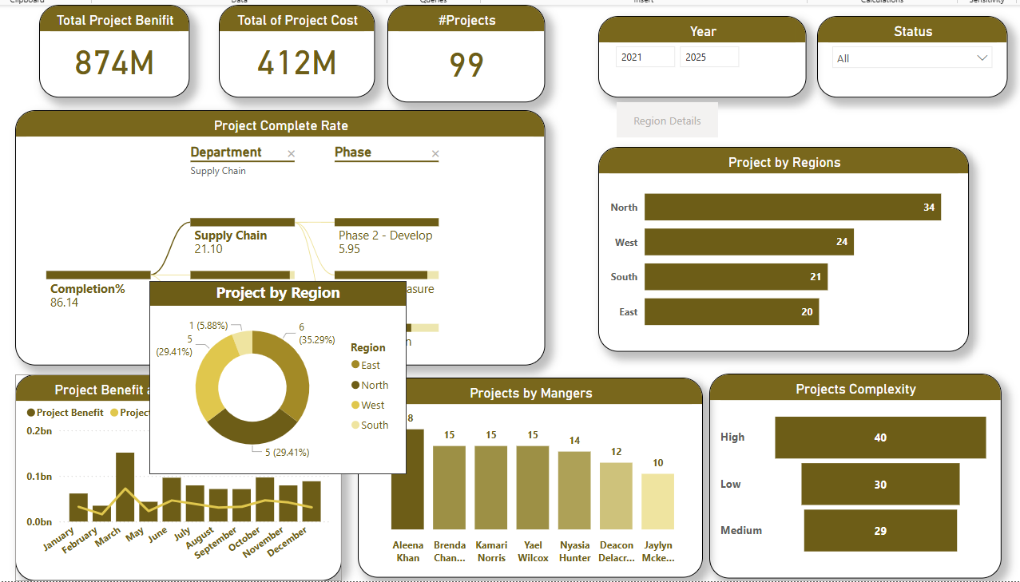
Projects Management

Slide 7
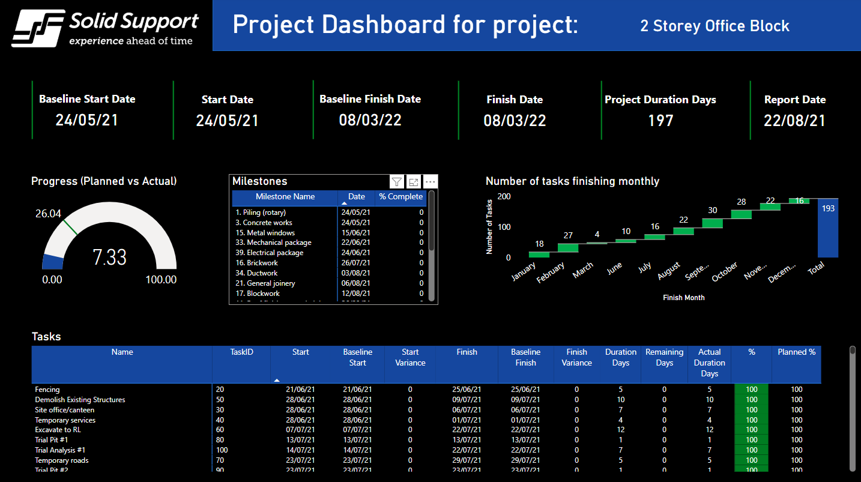
Projects Management

Slide 8
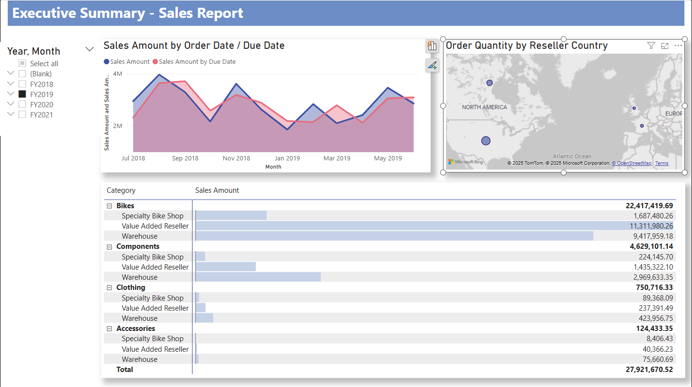
Sales Report

Slide 9
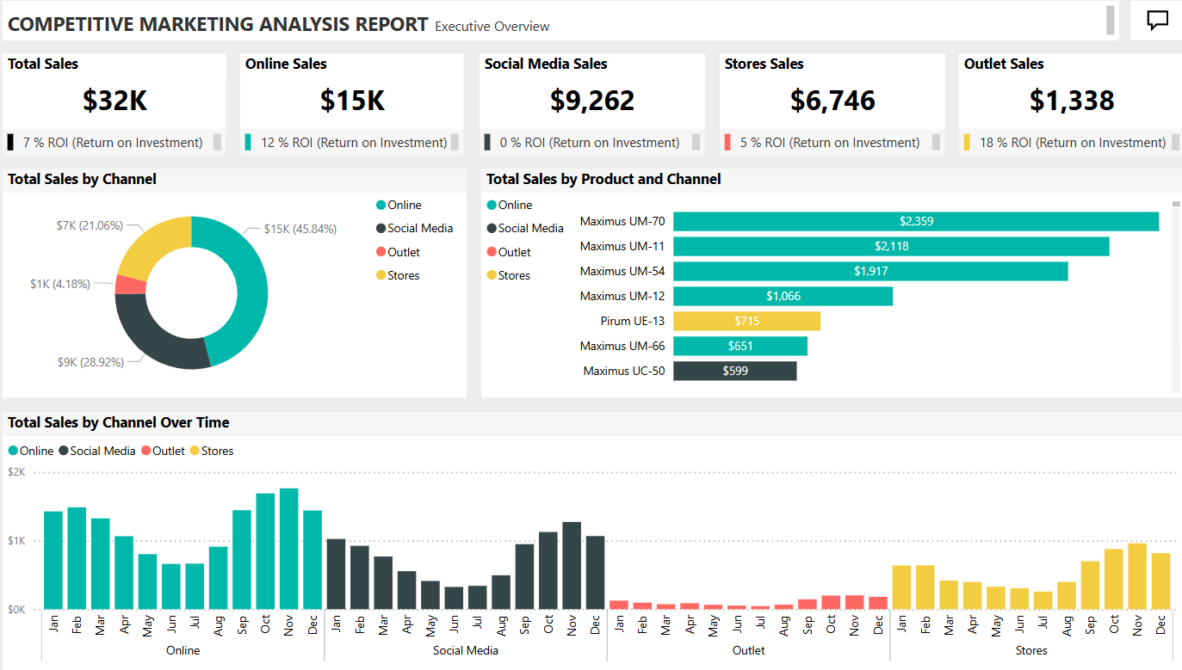
Marketing

Slide 10
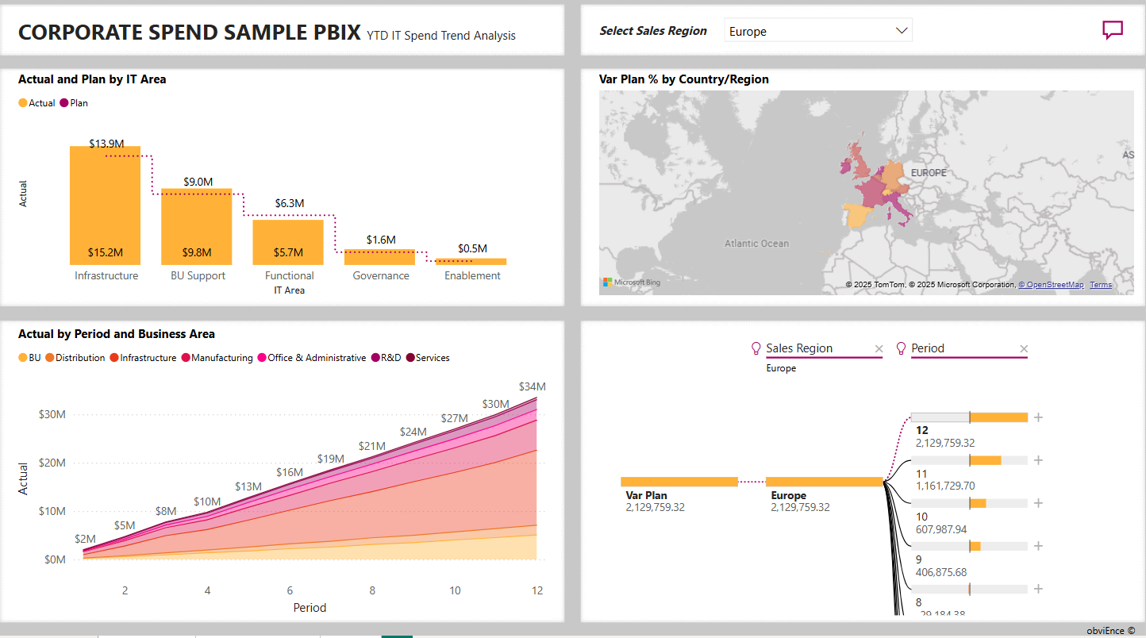
Corporate Sample Analysis

Slide 11
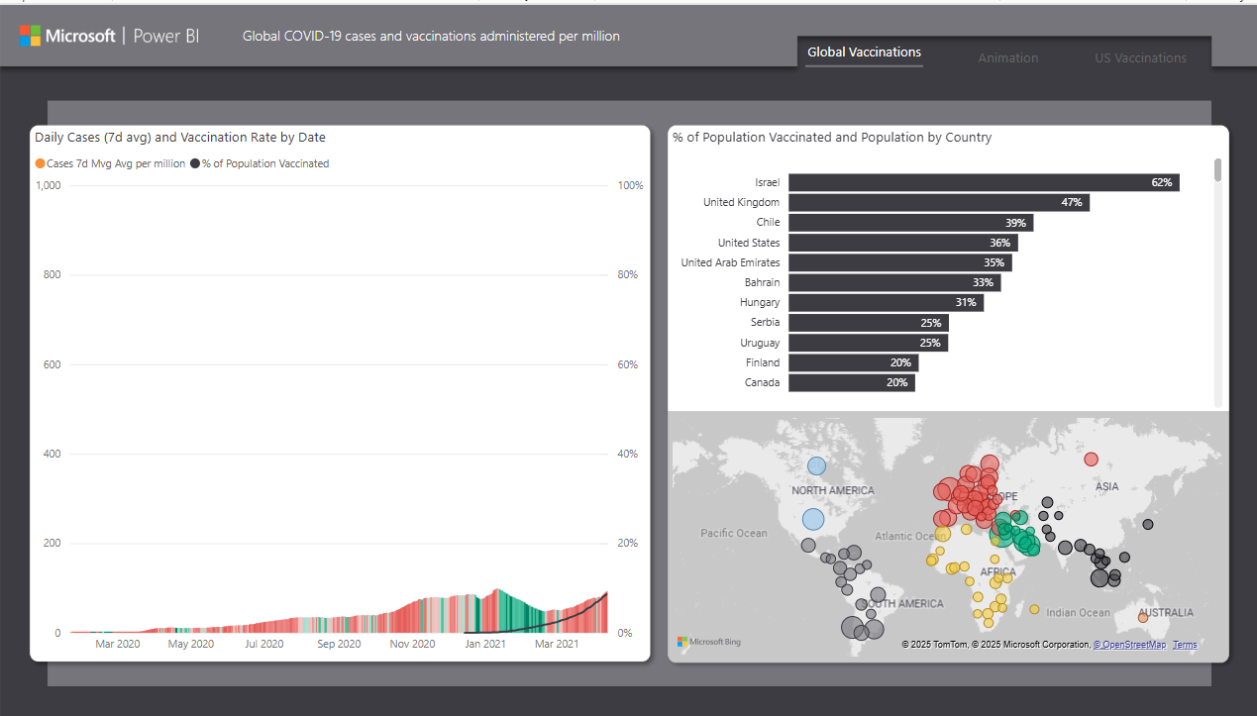
COVID Vaccination

Slide 12
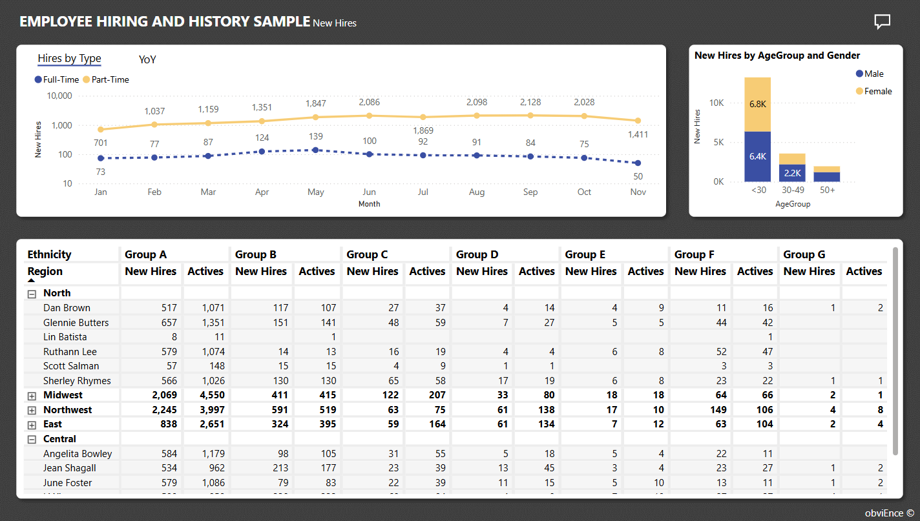
HR

Slide 13
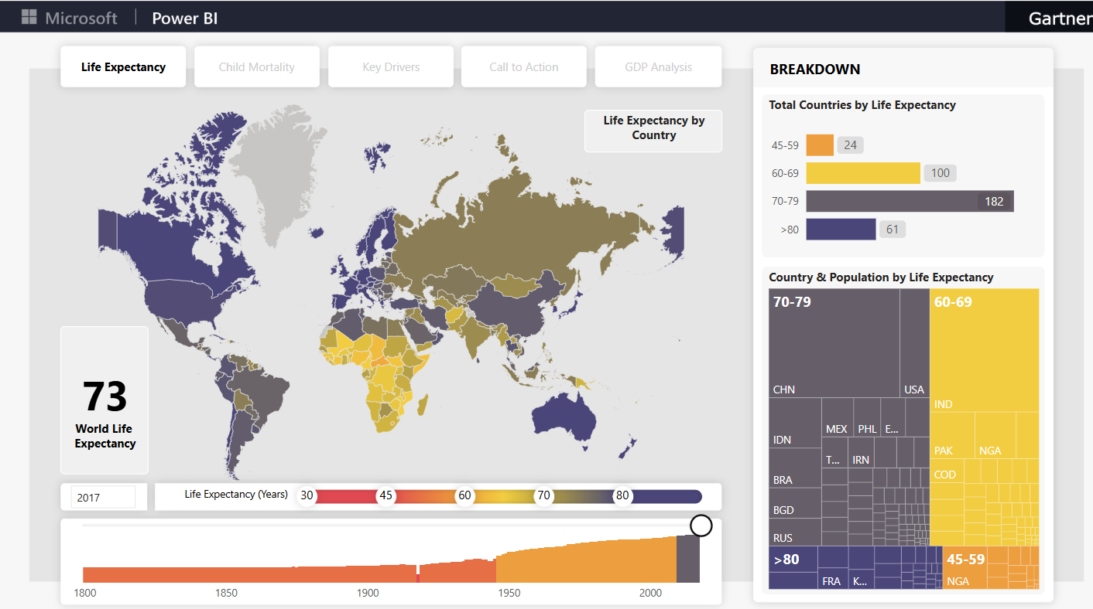
Life Expectancy

Slide 14

Tendering

Slide 15

Tendering

Slide 16
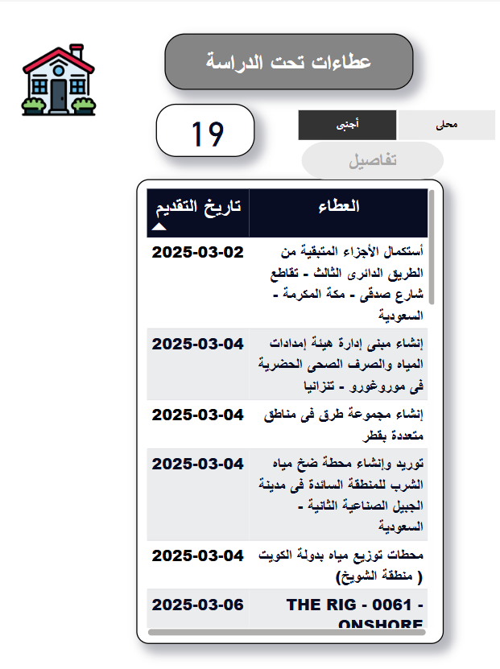
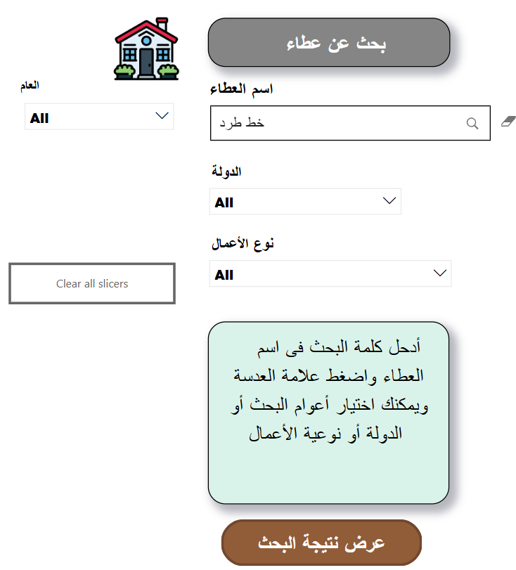


Tendering

Slide 17
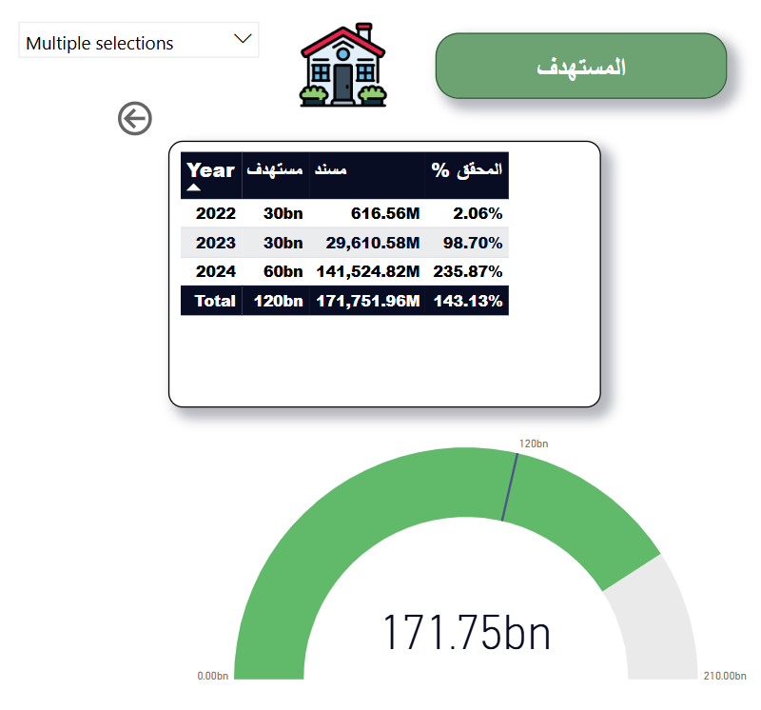

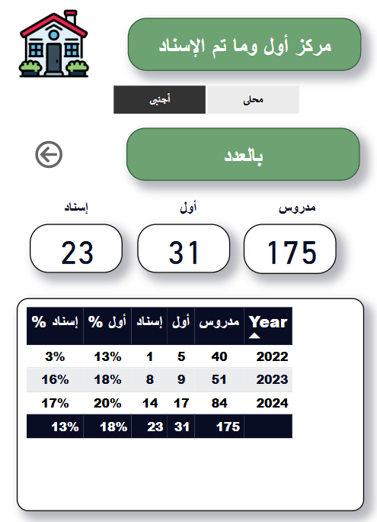
Tendering

Slide 18


